Slide 1

Being an adaptive leader in complex times
The adaptive skills you need for modern leadership
Notes:
Presenter notes:
This presentation is intended as guidance for applying adaptive leadership in a practical sense within Calabrio.
The important point to note is that adaptive leadership is not an exact science. It’s quite the opposite.
The goal is to give a broad overview of adaptive leadership and how it could be applied within the organization.

Slide 2

"Yesterday's adaptations are today's routines."
- Ronald Heifetz, The Practice of Adaptive Leadership
Notes:
Presenter notes:
Tease this quote from Ronald Heifetz, who we will feature prominently in this presentation.

Slide 3

Agenda:
  Leading with adaptive theory
  Adaptive theory defined
    Core tenants
    Examples
  Applying adaptive leadership
    6 steps to a different perspective
  Questions
  References
Notes:
Presenter notes:
Lay out the agenda for the presentation as per the list, focusing primarily on the first level of bullet points.
Remember to allocate time for questions at the end!

Slide 4

Leading with adaptive theory
Notes:
Presenter notes:
The first part of the presentation will lead with an overview of adaptive theory, its core tenants and some high-level examples.
This is not intended as a full summation of the theory, but primarily as context for the eventual six-step model outlined by Heifetz.

Slide 5

Adaptive theory defined
"Simply stated, adaptive leaders prepare and encourage people to deal with change."
"Adaptive leadership stresses the activities of the leader in relation to the work of followers in the contexts in which they find themselves."
Adaptive leadership is follower-centric, focusing on how leaders encourage employees to solve problems.
As adapted in Northouse (2018)
Notes:
Presenter notes:
The first two sentences outline what adaptive theory means. When we drill down to its essence, it is a recognition that many modern challenges aren’t resolved by leadership skill alone.
Focus in on the follower-centric portion of this slide. Calabrio’s mission is to foster human connections, and that’s what we want to do internally as well. It makes sense to apply a follower-focused philosophy to match customer-focused outward values.

Slide 6

CORE TENENTS
Adaptive leaders are relatable to their employees and teams.
Adaptive leaders empower their employees to tackle difficult challenges.
Adaptive leaders adjust to complexities within the organizational culture.
Notes:
Presenter notes:
These are only a few of the core tenants behind adaptive leadership theory. However, they are the most relevant for Calabrio’s case. Again, we play to the human connections and that involves being relatable, empowering and nimble to customer and employee needs.

Slide 7

EXAMPLE SCENARIOS
Administrators at a community college may use adaptive leadership to encourage employee input for widespread policy changes.
Teams within a corporate organization take time to consolidate one voice for the company, replacing stale scripts with an evolving value perspective.
Notes:
Presenter notes:
A few high-level examples of a specific adaptive practice.
In both cases, the adaptive skill focuses on empowerment of employees to tackle a challenge – even such difficult ones that involve issues of value or morality.

Slide 8

WHY ADAPTIVE?
Few companies operate within narrow-defined parameters. Allowing for flexibility can help leaders and followers adjust as new events arise.
Notes:
Presenter notes:
Summarize the key takeaways and core tenants from the previous slides.
This is a connection slide between the “why” of adaptive leadership and the “how.”
Flexibility is a key feature of our product. It should also be a key feature of our service.

Slide 9

How to apply an adaptive leadership process

Slide 10
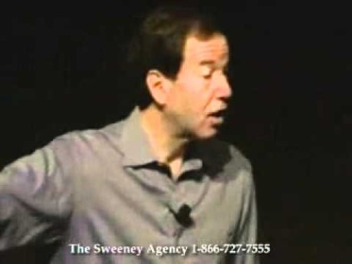
HEIFETZ'S MODEL OF ADAPTIVE LEADERSHIP

Slide 11
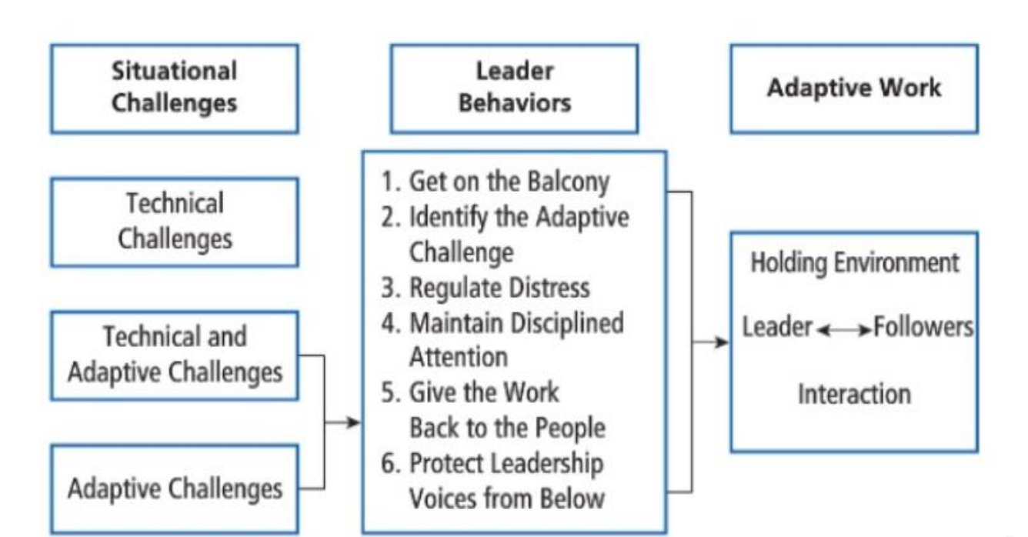
HEIFETZ'S MODEL OF ADAPTIVE LEADERSHIP
Developed by Ronald Heifetz, Founding Director of the Center for Public Leadership at the John F. Kennedy School of Government, Harvard University
As adapted in Northouse (2018)
Notes:
Presenter notes:
We’ve referenced Heifetz before, but now we’ll dive into his model for applying adaptive leadership.
6 steps and behaviors based on how a challenge is defined
Further work by Heifetz has delved deeper into each of these steps
We will be looking at each step with reference to our perspective of human connections

Slide 12
STEP 1: GET ON THE BALCONY
Adaptive leaders first assess the challenge by taking a step back. Rather than dive in directly, they survey the issue from a broader perspective. Convene a small group of advisors away from the fray to gain better insight. Alternate between observer and participant during the adaptive process.
Notes:
Presenter notes:
Getting on the balcony means pulling yourself away from the fray, if only for a moment.
Gives a better broad perspective
Allows you to isolate challenges and triggers
Can be done informally or formally
You can’t address the issue effectively if you don’t see the complete picture

Slide 13

STEP 2: IDENTIFY ADAPTIVE CHALLENGES
Most challenges within an organization fall into two categories: technical challenges and adaptive challenges.
Technical challenges can rely on established expertise within the team to solve. They usually involve numbers or static figures.
Adaptive challenges require more effort to address, often addressing issues of emotional or ethical standing.
Notes:
Presenter notes:
Give some examples of technical and adaptive challenges here.
Technical:
The server went down.
Power outages caused a service disruption
Budget figures were off because of a rounding error.
Adaptive:
The company’s value statement needs to be updated.
The messaging needs to be updated to match new customer expectations.
Siloed teams have resulted in misunderstandings with product updates.

Slide 14

Create a holding environment as a safe haven for people to express their feelings and opinions -- without fear of reprisal.
Provide direction and protection as employees address the adaptive change -- often with extensive stress and frustration.
STEP 3: REGULATE DISTRESS
Get your own act together and regulate personal stress. Be a role model for your team.
Notes:
Presenter notes:
Note that these are a few options available to regulate distress – the primary ones most relevant for Calabrio.
We have plenty of space to establish holding environments, whether physically or virtually.
Setting a good example and being a role model is especially important within these holding environments.

Slide 15

STEP 4: MAINTAIN DISCIPLINED ATTENTION
Leaders encourage and enable employees to focus on the difficult work ahead of them. This means they eliminate distractions and tamper avoidance behavior.
Notes:
Presenter notes:
Distraction and avoidance are huge barriers for adaptive change. That’s why leaders must give employees the space and time to adjust – but still guide them toward completion.
Adaptive leadership may be follower-centric, but it is not “hands-off” or lassiez-faire.

Slide 16
STEP 5: GIVE WORK BACK
TO THE PEOPLE
Adaptive leadership isn't done in a vacuum. The work must be returned to employees so they can see the adaptive change for themselves. Don't do all of it yourself.
Notes:
Presenter notes:
Bring this point back to the human connections mission. If we are in the business of showing our customers how their customers truly feel, then we need to do the same for our own team.
Heifetz and Northouse both argue that returning the work to the people is what separates adaptive leadership from self-serving pseudo-transformational leadership.
Describe how the work could be returned here:
Within small teams or individually
With gentle guidance to ensure completion
With accountability to the goal set up initially

Slide 17

STEP 6: PROTECT THE VOICES FROM BELOW
Listening is a key part of adaptive leadership. You need to listen to all of the voices on your team, especially those who dissent.
Further, you must encourage such voices to be open and honest, never attempt to silence or distract.
Everyone's voice is important. Everyone's perspective is needed.
Notes:
Presenter notes:
Understand that there will be dissenters to any adaptive change. Applaud that, don’t discourage it – so long as it is productive dissent.

Slide 18

EXERCISE: APPLYING ADAPTIVE LEADERSHIP AT CALABRIO
Divide into groups of four team members:
1 senior-level executive
1 sales lead
1 product lead
1 marketing lead
As a team, address the following situation using adaptive theory and practices:
Your team has been tasked by senior management to produce a new messaging platform for an upcoming product launch. Each team has its own perspective on how the product should be promoted, and there is very little agreement thus far.
How can you, as a team of leaders, get all these different teams to agree or accept a new messaging direction?
Now it’s your turn.
Notes:
Presenter notes:
This is a group role play activity. The goal is to get people to walk through the adaptive process for a common office occurrence – different values and goals among disparate teams.

Slide 19

The improvisational ability to lead adaptively relies on responding to the present situation rather than importing the past into the present and laying it on the current situation like an imperfect template.
- Ronald Heifetz, The Practice of Adaptive Leadership

Slide 20

Thank you!
Notes:
Presenter notes!
Remember to leave time for questions!

Slide 21
References
Corazzini, A. (2014). Adaptive leadership and person-centered care: A new approach to solving problems. North Carolina Medical Journal (Durham, N.C.), 75(5), 352–354.
Jefferies, S. (2017). Adaptive Leadership in a socially revolving world: A symbolic interactionist lens of adaptive leadership theory. Performance Improvement (International Society for Performance Improvement), 56(9), 46–50.
Heifetz, R. A., Heifetz, R., Grashow, A., & Linsky, M. (2009). The practice of adaptive leadership: Tools and tactics for changing your organization and the world. Harvard Business Press.
Northouse, P. G. (2018). Leadership: Theory and practice. Sage publications.
van der Hoven, P. (2015). Dynamic technology leadership: The adaptive role of the CTO. Research Technology Management, 55(5), 24–33. https://doi.org/10.5437/08956308x5505073

